Slide 1
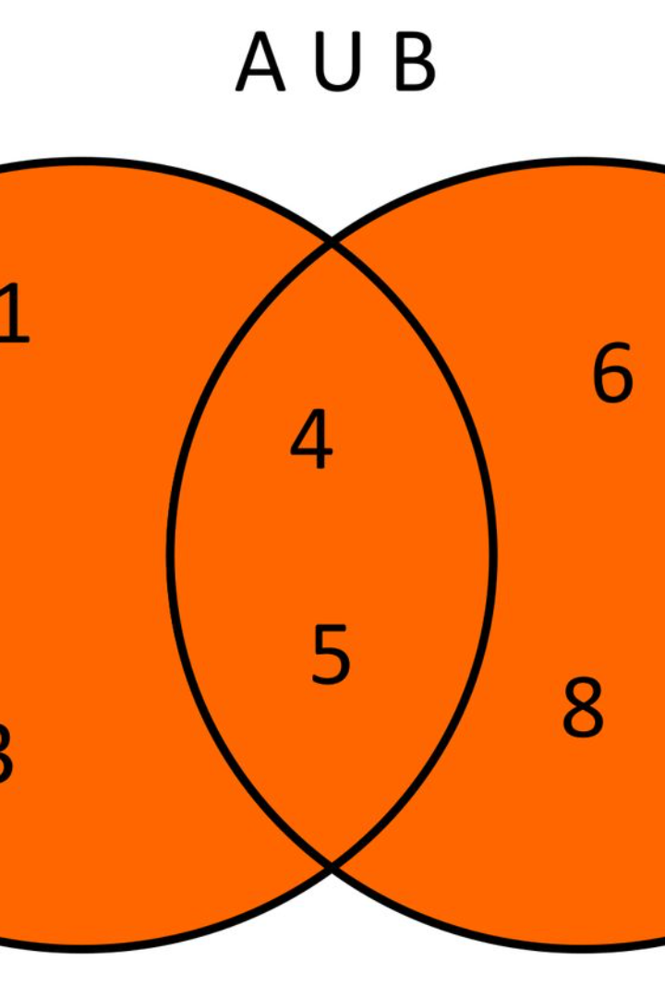

What is a union in C language?
In C language, a union is a special data structure that allows different data types to be stored in the same memory location. Unlike structures, where each member has its own memory space, the members of a union share the same memory space. This can be particularly useful when working with different types of data that need to be stored at the same memory location.
One key characteristic of unions is that they can only store one value at a time, unlike structures. This makes unions an efficient way to manage memory and manipulate different types of data within the C programming language.
aa
by ahmad faisal

Slide 2
Syntax and declaration of a union
Syntax
Declaration
In C language, a union is defined using the union keyword followed by the union name and a list of members. Each member can be a different type and the union size is the size of the largest member. Here's an example of declaring a union: union sampleUnion { int x; float y; char z; };
To declare a variable of the union type, you will use the union name followed by the variable name. For example: union sampleUnion myUnion; This allocates enough memory to store the largest member of the union.
Accessing Members
Potential Use Cases
Members of a union are accessed using the . (dot) operator. For example: myUnion.x = 10; assigns the value 10 to the integer member x of the union myUnion.
Unions are commonly used when there is a need to store different types of data in the same memory location, especially when the structure of the data is mutually exclusive. This can be useful in applications like interpreting the data of a sensor or handling different data types in a small memory footprint.

Slide 3
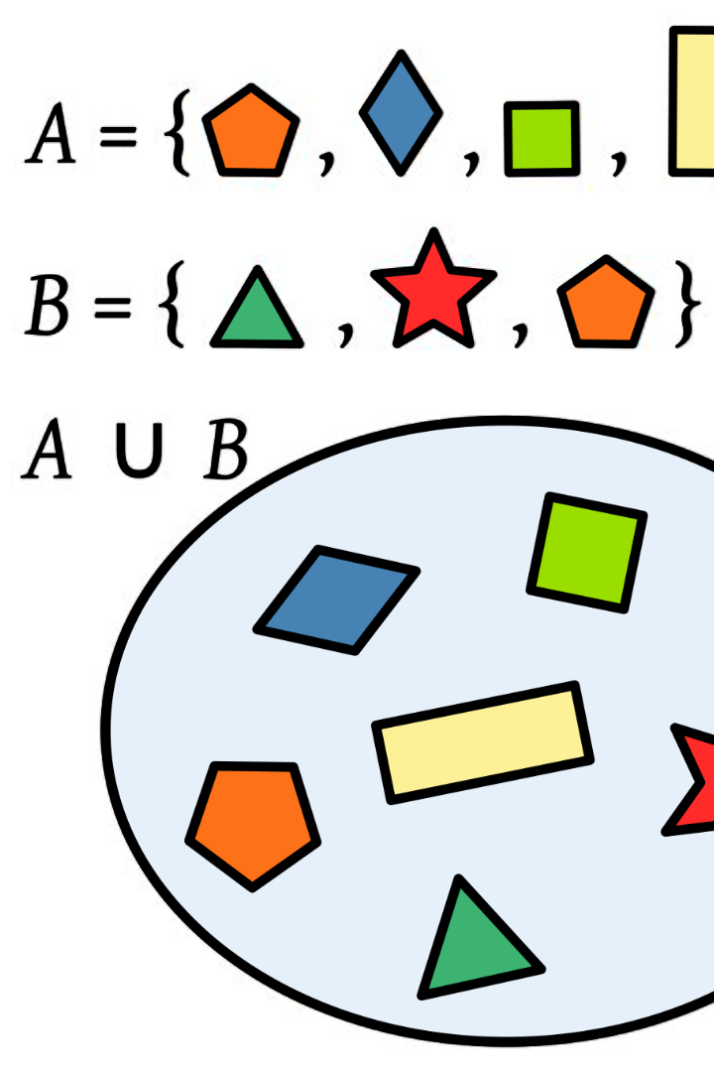
Accessing members of a union
Dot Operator: In C language, you can access the members of a union using the dot operator (.) followed by the member name.
Memory Allocation: When accessing members, keep in mind that all members share the same memory location, so changing the value of one member will affect the other members as well.
Member Usage: It's important to use the correct member based on the type of data stored in the union, ensuring proper typecasting and avoiding unintended data corruption.

Slide 4
Size and Memory Allocation of a Union
1
Size of a Union in C
When a union is declared in C, its size is determined by the size of its largest member. This means that the size of a union is equal to the size of its largest member. For example, if a union contains an integer variable of 4 bytes and a character variable of 1 byte, then the size of the union will be 4 bytes to accommodate the integer.
2
Memory Allocation
When a union is created, memory is allocated for the largest member of the union. This means that the union will occupy memory that is enough to hold its largest member. The size and memory allocation of a union are essential considerations when designing data structures and working with memory-efficient code in C.
3
Data Alignment
In some systems, the alignment and padding rules may lead to additional memory allocation for unions. It's important to consider data alignment and padding requirements when working with unions to ensure efficient memory usage and proper handling of the union's members.

Slide 5
Differences between a union and a structure
Definition
Memory Usage
Accessing Data
In C language, a structure is a collection of variables of different data types under a single name. It allocates memory for each member separately, which means that the total memory allocated is the sum of the memory requirements of each member. Conversely, a union is a special data type that allows storing different data types in the same memory location. It only allocates as much memory as the largest member, enabling space-saving storage of different data types.
Structures use memory equal to the sum of memory required by each member, whereas unions use memory equal to the memory required by the largest member. This difference in memory allocation makes unions more memory-efficient when storing different types of data, but it also means that only one member of the union can be accessed at a time.
When accessing members of a structure, each member is accessed independently using the dot (.) operator. In contrast, while accessing a union's members, the data from any of the members can be accessed, but using only one member at a time is recommended due to data integrity concerns.
Additionally, structures allow for simultaneous access to all members, while unions can hold different values at different times. This flexibility in a union's data handling introduces the need for careful consideration and implementation when utilizing unions in C programming.

Slide 6
Use cases and advantages of using unions
Memory Saving
Data Type Flexibility
Unions are advantageous in situations where memory allocation needs to be optimized. By allowing different data types to share the same memory space, unions can save memory and improve efficiency in embedded systems and memory-constrained environments.
Unions provide flexibility in handling different data types within the same memory location. This can be particularly useful when dealing with input/output operations, parsing binary data, or implementing hardware-related functionalities.
Efficient Network Packet Structures
Hardware Register Abstraction
In networking applications, unions are valuable for defining complex packet structures where different types of data need to be represented in a compact and efficient manner. This facilitates the handling and manipulation of network packets with minimal memory overhead.
Unions are commonly employed in low-level programming to abstract hardware registers, enabling a unified interface for interacting with diverse register configurations while optimizing memory usage and ensuring efficient utilization of hardware resources.

Slide 7

Limitations and considerations when using unions
When using unions in C language, there are several important limitations and considerations to keep in mind. Firstly, unions can only store a single value at a time, as opposed to structures which can store multiple values. This means that unions are limited in their ability to represent complex data structures.
Additionally, accessing different members of a union can lead to ambiguities and potential issues, especially if the members have different sizes or data types. This can make union usage error-prone and requires careful handling of the data to avoid unexpected results.
Another consideration is that the memory allocated for a union is based on the size of its largest member, which can lead to wastage of memory if the other members are smaller. This makes unions less efficient in terms of memory utilization compared to structures.
Furthermore, unions do not provide any means of data validation or type checking, which can make it challenging to ensure the integrity of the data stored in the union.

Slide 8

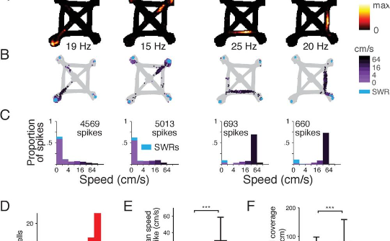

Examples of union implementation in C
Struct and Union Example
Memory Representation Example
Application Example
In C, unions are often used to create data structures that can hold different types of data. For example, a union can be used to represent a complex number that consists of a real and imaginary part. This image shows a code example of a struct and union implementation in C, demonstrating how unions can be utilized for versatile data representation.
Unions in C can be applied in various scenarios, such as implementing a flexible data structure or handling different data types within a single variable. This image provides an example of an application of unions in C, highlighting the versatility and practical use cases of unions in real-world programming.
When a union is used in C, memory allocation is a crucial aspect to consider. This image visually represents the memory allocation for a union in C, showcasing how the different members of the union share the same memory space. Understanding the memory representation of a union is essential for efficient memory usage in C programs.

Slide 9



Common Mistakes and Pitfalls with Unions
Confusing with Structs
Incorrect Type Conversion
Undefined Behavior
One common mistake when working with unions is confusing them with structures. While both unions and structures are used to store multiple variables, unions differ in how they allocate memory, and accessing one member may affect the value of others. It's important to understand the key differences to avoid unintended consequences in your code.
Another pitfall is improper type conversion. Due to the shared memory allocation of union members, improper type casting can lead to unpredictable behavior and data corruption. Care must be taken to ensure that type conversion is done correctly to avoid runtime errors and unintended results.
Unions can lead to undefined behavior if not used carefully. Accessing the wrong member or accessing a member that is not currently in use can lead to unreliable and unpredictable results. It's crucial to pay close attention to memory allocation and member access to prevent undefined behavior in your code.

Slide 10
Conclusion and Key Takeaways
1
2
Simplicity
Versatility
3
4
Efficiency
Considerations
After exploring the concept, syntax, declaration, memory allocation, differences, use cases, limitations, examples, mistakes, and pitfalls of unions in C language, it is evident that unions provide simplicity due to their ability to allocate memory for only one member at a time, versatility in handling multiple data types, efficiency in space utilization, and considerations in the proper and careful usage of unions to avoid unintended consequences.
When implementing unions, it is important to carefully consider the trade-offs and limitations while leveraging their advantages to meet specific programming requirements. By understanding these aspects, developers can effectively harness the power of unions in C language to optimize program design and memory utilization.

